Slide 1



Small Monster War
(practice project)
Spring MVC , Hibernate , Maven
Put All together

Slide 2
Problem ?
We need to design a web app that will (create , read , update, delete) products of a specific ecommerce using:
spring mvc for backend ,
hibernate for database operations
MySQL for data store
maven for dependency management
Bootstrap , HTML and CSS for frontend
Git/Github for project management (MANDATORY)
Make a screencast (small video 1.5 min) showing the project and output and post it to linkedin (MANDATORY)

Slide 3
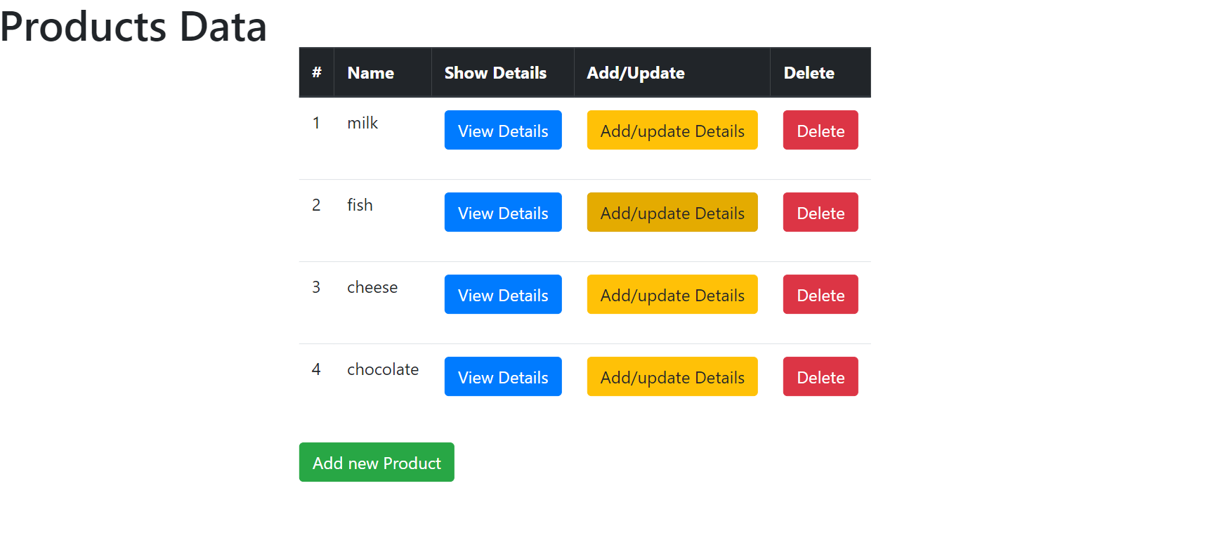
Home Page

Slide 4
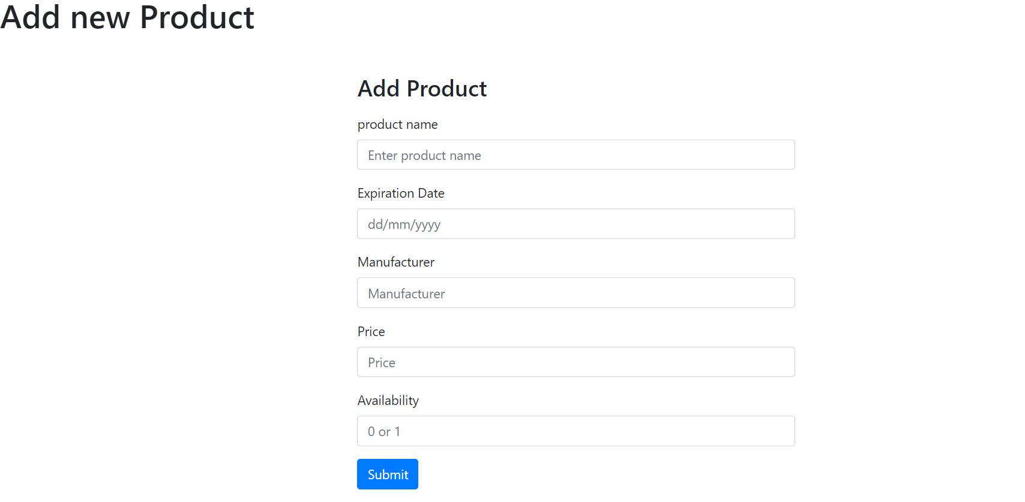
Optional - you can add the product image - challenge yourself and learn how to store image in the database using hibernate
1 - upload the image using the frontend
2- store the image beside the product details inside the database
Add Product Page

Slide 5
Points that not covered in the live session and will be attached to the record of the session
How to handle date in the form of dd/mm/yyyy (ie: 18/04/2024)
For Get and Post request methods in the controller , Does we need to change the method of the form in jsp which handled by the POST/GET controller ?
For @Transactional , do we need to specify it to each method or can be added to the class level ?
For the lazy loading , does we need to enable it or it works by default ?

